Slide 1
Updating and Improving the INTAMAP web service
Madhu Rani
2012 Intern

Slide 2
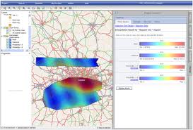
Introduction to INTAMAP
INTAMAP stands for INTeroperability and Automated MAPping
Objective is map critical environmental variables including anomalies and extreme events referred as hot spots, reported by heterogeneous networks by developing and implementing methods in open source tools
INTAMAP also quantifies the uncertainities associated with the interpolated maps.

Slide 3
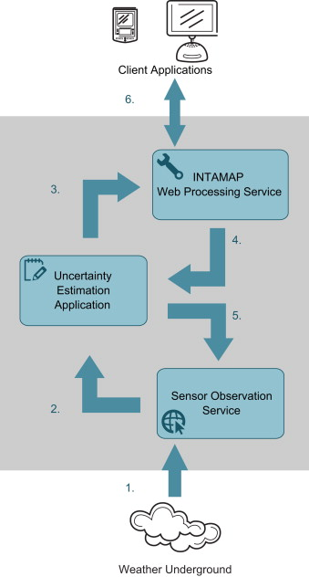
Introduction to INTAMAP (2)
The INTAMAP WPS is built on 52 North WPS framework
Flow diagram for depicting INTAMAP:
Overview of the system architecture shows the flow of data from the weather underground site to the end-user client application

Slide 4
SOAP/WSDL as an alternative to WPS
WPS (Web Processing service) is a standard developed by OGC for exposing geospatial processing functionality including complex environmental models over the web
SOAP (Simple Object Access Protocol) is a protocol for exchanging structured information in networked web services and WSDL (Web services description language) is a new specification to describe these services. These two standards are defined by W3C.

Slide 5
SOAP/WSDL as as alternative to WPS (2)
With SOAP/WSDL creating clients is straightforward. These are widely used web service standards and are compatible with sooftware like Taverna and Kepler & workflow standards like BPEL.
Using tools such as Apache Axis and Microsoft Visual Studio, SOAP/WSDL web service can be quickly deployed from existing code. It will make easier to integrate applications with web services.
A concrete WSDL document import required input and data types immediately
Client development is also restricted by the lack of tool and community support.
Interoperability is affected due to due to generic interface (that allows publishing of all processes) . Generic description of data types also creates a lot of ambiguity in consuming a service.
A complex sequence of GetCapabilities() for listing process identifiers, DescribeProcess() for full description of the process and Execute() for actually processing the request

Slide 6
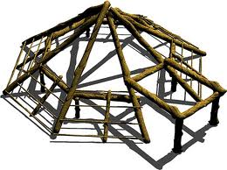
Introduction to ps-framework
It is a generic java-based framework for exposing services on the web
It has two interfaces : SOAP/WSDL and JSON
Developers can easily use the framework by extending AbstractProcess class.
Framework automatically generates WSDL document.
In addition to exposing a concrete WSDL docment, the service uses a fixed pattern for process requests and responses.
All exceptions caught within the framework are returned to user as standard fault elements.

Slide 7
Interpolate service from ps-framework
Goal : To implement a SOAP/WSDL based web service using R back-end for interpolation
Input : Observations either as string in CSV format or path to JSON file
Output : Execution status for all the R commands
RConnection class is used for establishing connection with rserve.
Prediction grid is generated by taking the bounding box around provided observation locations. It will have at least 100 grid points.

Slide 8
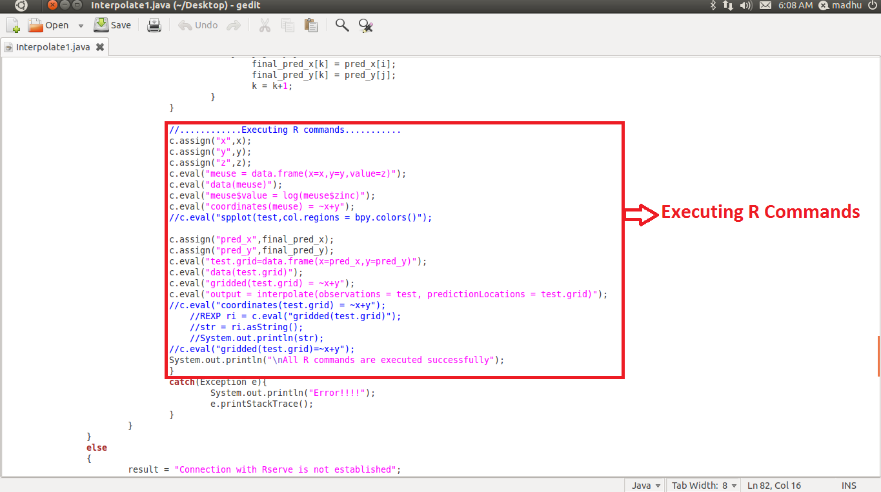

Slide 9
Interpolate-Octave service
Octave is a high-level interpreted language, primarily intended for numerical computations.
Goal : To implement SOAP/WSDL service having interpolation back-end in octave
Input : Format (CSV or JSON), Observations and Prediction –Locations
Output : Execution status as Output, Mean-Predictions and Standard-Deviation-Predictions
JavaOctave package is used for bridging between java and octave.
Any octave command can be executed by adding a simple command in octaveCommands() function.

Slide 10
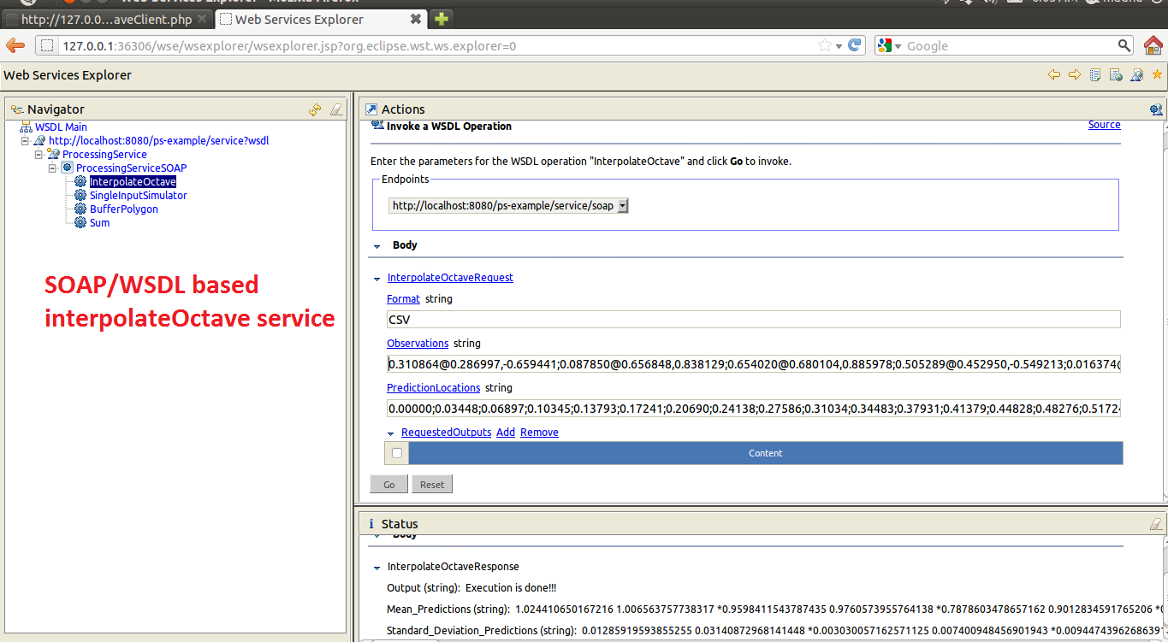

Slide 11
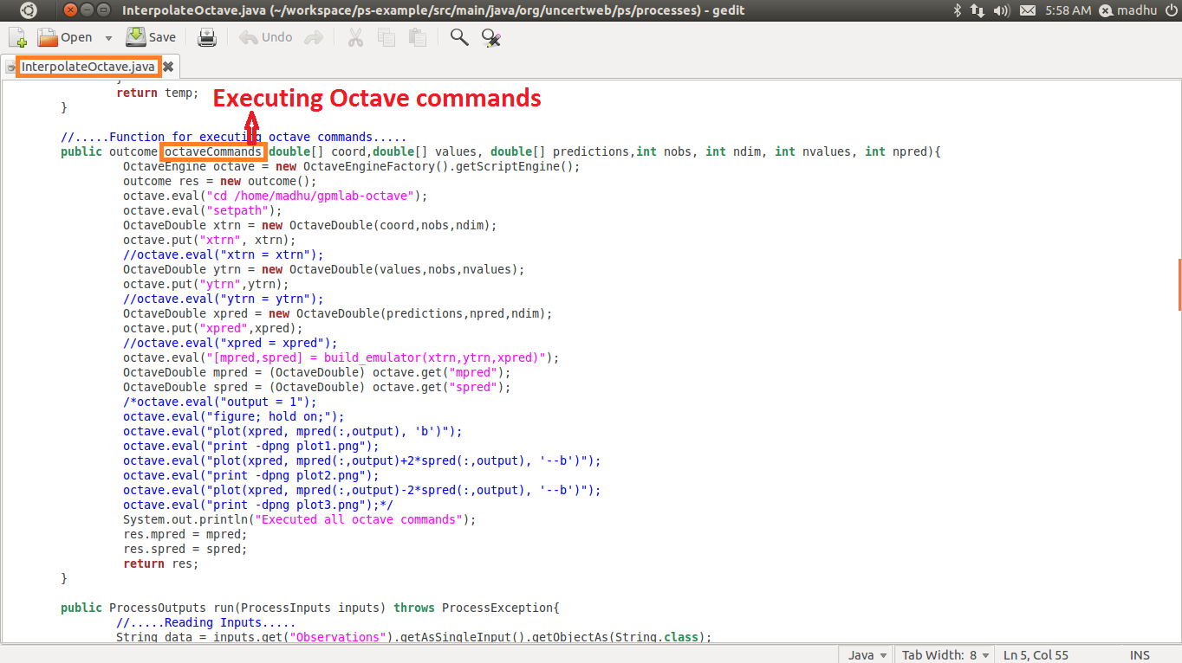

Slide 13
Interface for Interpolate-Octave service
A web-based client TryInterpolateOctave similar to TryIntamap is developed using Ajax, Javascript, PHP and HTML for testing the service.
User has to select Format, Observations and Prediction-Locations from the drop-down menus in any of the two available formats – CSV or JSON.
Execution status, Mean-predictions and Standard-Deviation-Predictions will be shown as result.

Slide 14
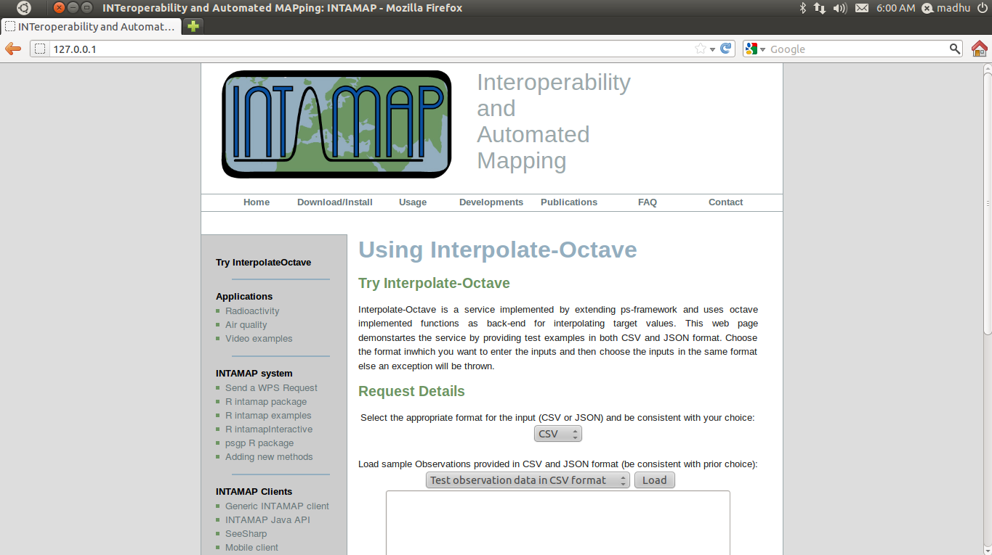

Slide 15
Future work
Back-end for InterpolateOctave service can be developed further to incorporate complete functionality of INTAMAP like anisotropy detection, outlier detection etc.
Support for other input formats like XML can be added in the InterpolateOctave service.
Developing test case for Interpolate service and its deployment.

Slide 16
References
ICT for Sustainable Growth – INTAMAP
www.intamap.org
Edzer Pebesma, Dan Cornford, Gregoire Dubois, Gerard B.M. Heuvelink, Dionisis Hristopulos, Jurgen Pilz, Ulrich Stohlker, Gary Morin, Jon O. Skøien. INTAMAP: The design and implementation of an interoperable automated interpolation web service. Computers & GeoSciences, Volume37 : 2011: Pages 343-352
Matthew Williams, Dan Cornford, Lucy Bastin, Richard Jones, Stephen Parker. Automatic processing, quality assurance and serving for real-time weather data. Computer & Geosciences , Volume 37: Issue 3: March 2011 :Pages 353–362
Jones, Richard; Cornford, Dan and Bastin, Lucy (2012). Uncertweb processing service : making models easier to accesson the web

